Slide 1
Analyze and Compare Tech Hubs in Canada
Presentation by: Shivani Sheth

Slide 2
Abstract
In this project, we take leverage of the Foursquare API to find the most popular places in each of the neighborhoods consisting of British Columbia. A place is marked as “happening” by the Foursquare API according to the number of people present at a given place and hence the place is updated in real-time; it might change every few minutes. We then cluster the neighborhoods based upon their preferred places in the surrounding area. This will give a clear picture of the aura or the vibe of the place, which can help an individual know what to expect in the neighborhood, and hence decide upon a suitable location according to their preference. Finally, we also compare it with Toronto, another widely preferred city among prospective students, and brief upon the similarities and dissimilarities based upon its neighborhood.

Slide 3
Data Acquisition and Cleaning
Table scrapped from libraryhttps://www.geonames.org/postal-codes/CA/BC/british-columbia.html using the read_html function of the Pandas.
Extract alternate address rows of this table in a separate data frame, say ‘temp_df’. For this, we loop over the number of records in a multiple of two and fetch each row. This will give us a total of 192 rows containing the neighborhood address of British Columbia.
Delete all except one column for the coordinates and merge the temp_df with the original df.
Separate latitude and longitude values from the coordinates string and convert into float.

Slide 4
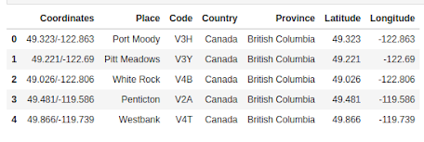
Cleaned and Pre-processed Data

Slide 5
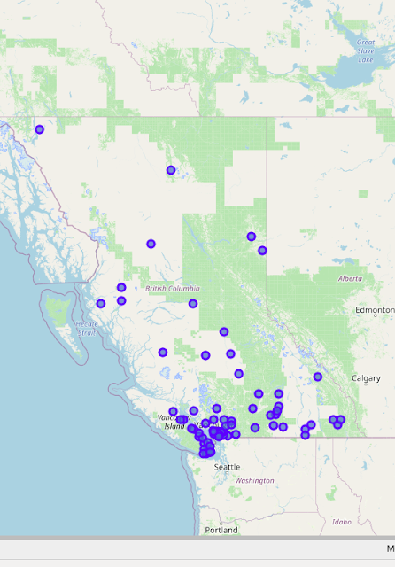
Methodology
Outline the British Columbia map and superimposing all of the neighborhoods, from our data frame, onto the map.
Utilize the Folium library to visualize the map.
Extract the coordinates of the British Columbia province through the geocoder package of the geopy library.

Slide 6
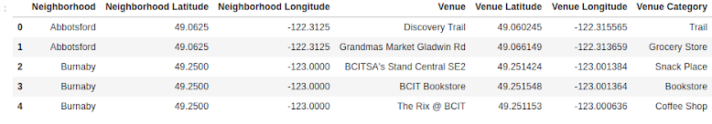
Methodology - Explore
Here, we leverage the Foursquare API in this section to explore the nearby venues of each neighborhood.
For each set of neighborhood names and coordinates, we prepare a URL request string and send a GET request. The output is the JSON file, from which we extract the nearby locations and store them in a data frame.
Check the number of venues returned for each neighborhood and observe that we have 76 unique venues.

Slide 7
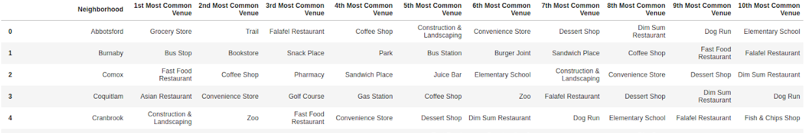
Methodology - Analyze
To analyze each neighborhood, we use the one-hot encoding technique and map the nearby venue categories against each neighborhood into a series of 0’s and 1’s. The categories that are present in the neighborhood are marked by 1, and the ones that aren't present in that neighborhood are marked by 0.
Add the neighborhood names corresponding to their values in the data frame and calculate the mean of venue categories present.
Arrange the top ten venues of each neighborhood and display it in a separate data frame

Slide 8
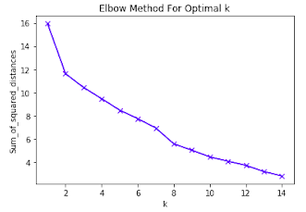
Methodology - Cluster
Cluster neighborhoods according to their top most common venues using the k-means clustering algorithm.
Use the elbow method for choosing the optimal number of clusters, or ‘k’.
The elbow point is k=8. We run the k-means to cluster the neighborhood into eight different clusters.

Slide 9
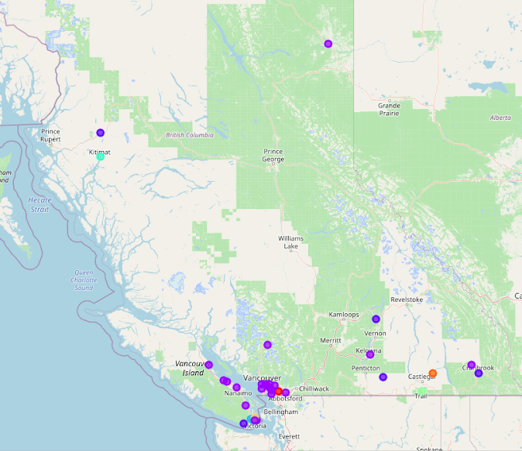
Methodology - Cluster
Extract the cluster labels for each neighborhood and append it to the ‘top venues’ data frame.
Append the postal codes and coordinates from our original data frame into this new ‘top venues’ data frame.
Visualize the neighborhood clusters superimposed onto the British Columbia map marked by different cluster colors.

Slide 10
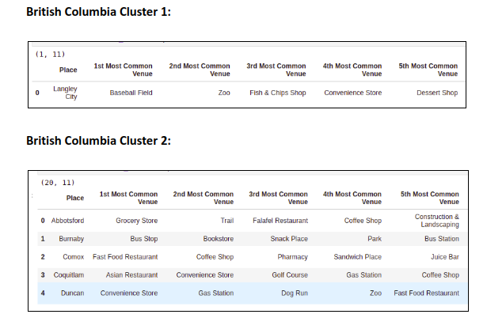
Results

Slide 11
Results

Slide 12
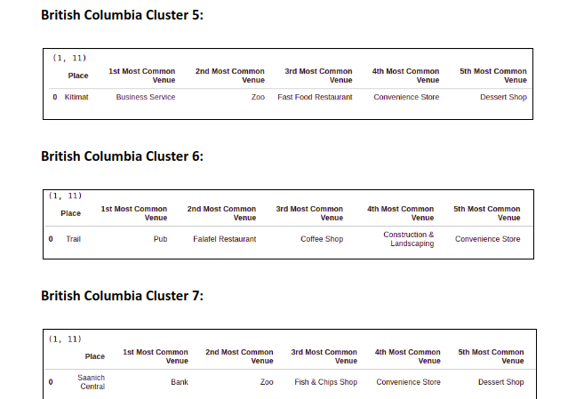
Results

Slide 13
Conclusion
The neighborhood clusters define the type of locality and can be used by different people to choose their preferred area of interest accordingly. For example, clusters involving a locality that has baseball fields, zoos in their most popular nearby venues and hence would be more suitable for a younger generation, preferably kids in their middle schools. On the contrary, the clusters involving a locality that has grocery shops, fast food shops, and convenience stores as their popular nearby locations would be more suitable for college students, who would need all of these on an almost daily basis.
Hence, these clusters provide a basic guide or a map on the different types of neighborhoods in British Columbia and give an idea of what to expect in that neighborhood.

